Slide 1
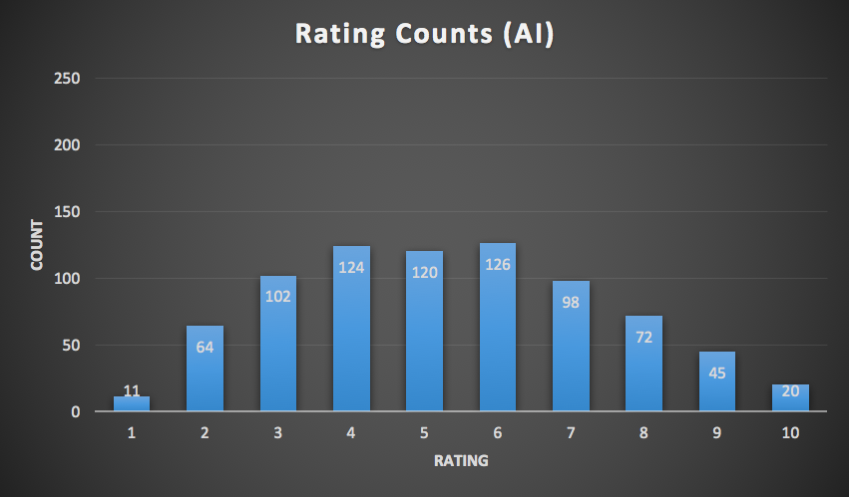
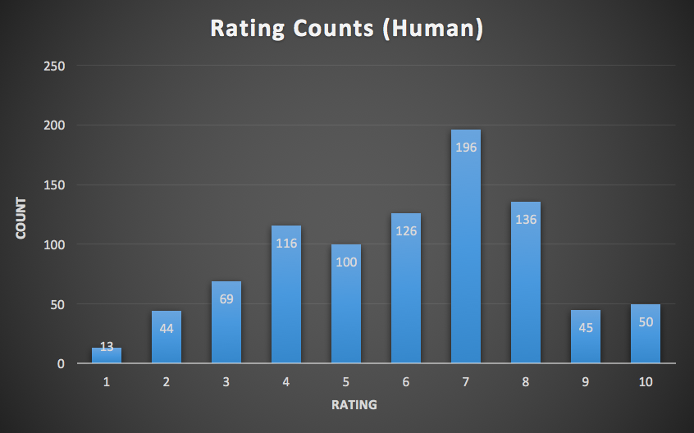
Robot Music: Beat Generation with Factor Graphs
Han Lin Aung, Justin Xu, Sicheng Zeng
Background
Ran a maximum likelihood estimation likelihood over each cluster of example beats to get an estimation of the conditional probabilities. (Figures 3,4,5)
Simulated a creation of a new beat by iteration through the blocks and assigning the block to on with probability given by the Bayesian graph.
Automatically generate and create new music beats, focusing on rap and hip-hop beats
See if machine generated music is comparable to that of the humans
Creative domain - splice beatmaker defined a 2 measure beat structure as an 8x32 grid that can be turned on or off
Results
Mean: 4.273 Std: 2.126
Mean: 4.891 Std: 2.362
Figure 6: AI Ratings
Figure 7: Human Ratings
Figure 1: Factor Graph
Surveyed people to give ratings(on a scale of 1-10)
Figure 8:
Example output for created beat
Figure 2: Key
Figures 3,4,5: Low, medium, high density conditional probabiltiies
Methodology
Conclusion
Constructed a Bayesian network such that each node depended on the beat right before and right above it. (Figure 1)
Ran a k-means algorithm on the note density of the example beats to separate each set into a group of low, medium, and high density clusters.
Centroid weights were approximately (12,50,100) out of 256 possible blocks
Without k-means, the data had too much variance, so the separation made the generation of music more segmented and clearer
Promise in using MLE, and factor graphs to generate beats, or even melodies
Our algorithm produced beats at a quality that is at least comparable to that of an average casual beatmaker
After using K-means to classify dataset into different densities of beats, beats trained on low-density dataset scored higher ratings
Future: Gather more data and ratings on low, medium, high densities of beats to dive deeper into mechanics of generating better sounding music

